Slide 1
微處理機系統 &微處理機系統實習

Slide 2
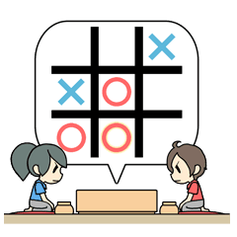
Source: https://store.line.me/stickershop/product/1340743/zh-Hant?utm_expid=.m6zVmes5SwW6xdiajiLatw.0&utm_referrer=https%3A%2F%2Fstore.line.me%2Fstickershop%2Fproduct%2F1340743%2Fen

Slide 3
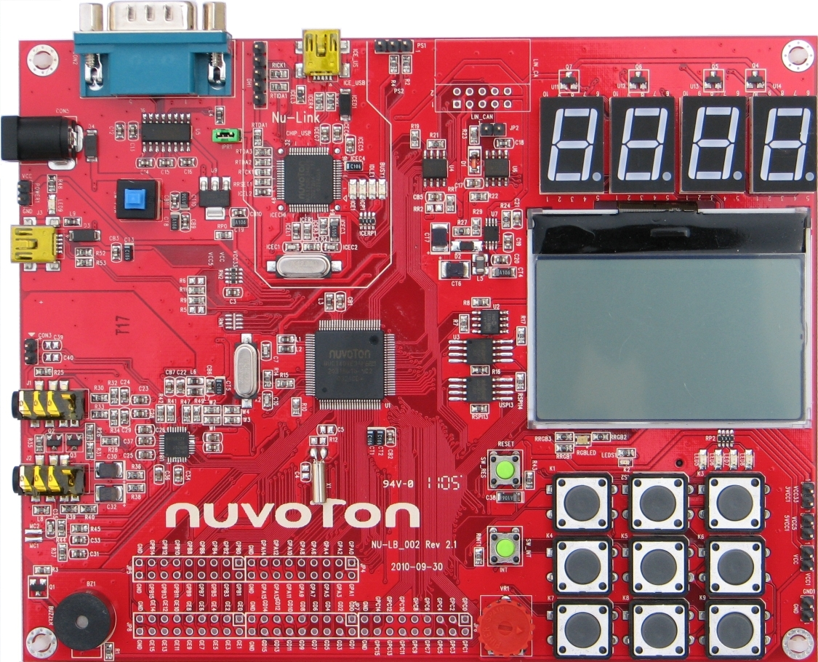
LCD
128x64 pixels
SPI interface

Slide 4
16
16
16
80
用來顯示哪方獲勝
16
16
16
16

Slide 5
extern void draw_Bmp8x8(int16_t x, int16_t y, uint16_t fgColor, uint16_t bgColor, unsigned char bitmap[]);
extern void draw_Bmp32x8(int16_t x, int16_t y, uint16_t fgColor, uint16_t bgColor, unsigned char bitmap[]);
extern void draw_Bmp120x8(int16_t x, int16_t y, uint16_t fgColor, uint16_t bgColor, unsigned char bitmap[]);
extern void draw_Bmp8x16(int16_t x, int16_t y, uint16_t fgColor, uint16_t bgColor, unsigned char bitmap[]);
extern void draw_Bmp16x8(int16_t x, int16_t y, uint16_t fgColor, uint16_t bgColor, unsigned char bitmap[]);
extern void draw_Bmp16x16(int16_t x, int16_t y, uint16_t fgColor, uint16_t bgColor, unsigned char bitmap[]);
extern void draw_Bmp16x24(int16_t x, int16_t y, uint16_t fgColor, uint16_t bgColor, unsigned char bitmap[]);
extern void draw_Bmp16x32(int16_t x, int16_t y, uint16_t fgColor, uint16_t bgColor, unsigned char bitmap[]);
extern void draw_Bmp16x40(int16_t x, int16_t y, uint16_t fgColor, uint16_t bgColor, unsigned char bitmap[]);
extern void draw_Bmp16x48(int16_t x, int16_t y, uint16_t fgColor, uint16_t bgColor, unsigned char bitmap[]);
extern void draw_Bmp16x64(int16_t x, int16_t y, uint16_t fgColor, uint16_t bgColor, unsigned char bitmap[]);
extern void draw_Bmp32x16(int16_t x, int16_t y, uint16_t fgColor, uint16_t bgColor, unsigned char bitmap[]);
extern void draw_Bmp32x32(int16_t x, int16_t y, uint16_t fgColor, uint16_t bgColor, unsigned char bitmap[]);
extern void draw_Bmp32x48(int16_t x, int16_t y, uint16_t fgColor, uint16_t bgColor, unsigned char bitmap[]);
extern void draw_Bmp32x64(int16_t x, int16_t y, uint16_t fgColor, uint16_t bgColor, unsigned char bitmap[]);
extern void draw_Bmp64x64(int16_t x, int16_t y, uint16_t fgColor, uint16_t bgColor, unsigned char bitmap[]);
extern void draw_LCD(unsigned char *buffer);
extern void print_Line(int8_t line, char text[]);

Slide 6
extern void draw_Bmp8x8(int16_t x, int16_t y, uint16_t fgColor, uint16_t bgColor, unsigned char bitmap[]);
extern void draw_Bmp32x8(int16_t x, int16_t y, uint16_t fgColor, uint16_t bgColor, unsigned char bitmap[]);
extern void draw_Bmp120x8(int16_t x, int16_t y, uint16_t fgColor, uint16_t bgColor, unsigned char bitmap[]);
extern void draw_Bmp8x16(int16_t x, int16_t y, uint16_t fgColor, uint16_t bgColor, unsigned char bitmap[]);
extern void draw_Bmp16x8(int16_t x, int16_t y, uint16_t fgColor, uint16_t bgColor, unsigned char bitmap[]);
extern void draw_Bmp16x16(int16_t x, int16_t y, uint16_t fgColor, uint16_t bgColor, unsigned char bitmap[]);
extern void draw_Bmp16x24(int16_t x, int16_t y, uint16_t fgColor, uint16_t bgColor, unsigned char bitmap[]);
extern void draw_Bmp16x32(int16_t x, int16_t y, uint16_t fgColor, uint16_t bgColor, unsigned char bitmap[]);
extern void draw_Bmp16x40(int16_t x, int16_t y, uint16_t fgColor, uint16_t bgColor, unsigned char bitmap[]);
extern void draw_Bmp16x48(int16_t x, int16_t y, uint16_t fgColor, uint16_t bgColor, unsigned char bitmap[]);
extern void draw_Bmp16x64(int16_t x, int16_t y, uint16_t fgColor, uint16_t bgColor, unsigned char bitmap[]);
extern void draw_Bmp32x16(int16_t x, int16_t y, uint16_t fgColor, uint16_t bgColor, unsigned char bitmap[]);
extern void draw_Bmp32x32(int16_t x, int16_t y, uint16_t fgColor, uint16_t bgColor, unsigned char bitmap[]);
extern void draw_Bmp32x48(int16_t x, int16_t y, uint16_t fgColor, uint16_t bgColor, unsigned char bitmap[]);
extern void draw_Bmp32x64(int16_t x, int16_t y, uint16_t fgColor, uint16_t bgColor, unsigned char bitmap[]);
extern void draw_Bmp64x64(int16_t x, int16_t y, uint16_t fgColor, uint16_t bgColor, unsigned char bitmap[]);
extern void draw_LCD(unsigned char *buffer);
extern void print_Line(int8_t line, char text[]);

Slide 7
實作
完成井字遊戲
開啟LED背光
OX輪流畫上九宮格（蜂鳴器短聲）
確認何方獲勝後，於最下方顯示資訊（蜂鳴器長聲）
按任意鍵後重新開始遊戲

